Slide 1
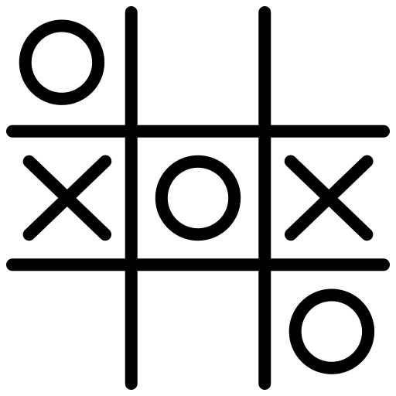
TIC TAC TOE GAME DEVELOPMENT USING AI BOT
MINI PROJECT
By Samyak Ubale – TE COMP
Pratik Tikare – TE COMP
Shivam Singh – TE COMP

Slide 2
INTRODUCTION
Tic-Tac-Toe is a classic two-player game that has been widely used to demonstrate artificial intelligence (AI) techniques in games. This project aims to develop an intelligent Tic-Tac-Toe game where a human player competes against an AI opponent powered by the Minimax Algorithm.
The Minimax Algorithm is a decision-making strategy used in game theory and AI to find the best possible move in a two-player game. The AI evaluates all potential moves, predicts future game states, and selects the move that minimizes the opponent's chances of winning while maximizing its own chances.

Slide 3
SYSTEM DESIGN
The Tic-Tac-Toe AI system consists of three main components:
User Interface (UI)
Displays the Tic-Tac-Toe board.
Allows users to interact with the game (clicking cells in GUI or entering moves in a console).
Shows game status (win, draw, or ongoing).
Game Logic
Manages the rules of Tic-Tac-Toe.
Checks for valid moves, win conditions, and draws.
Alternates turns between the player and AI.

Slide 4
SYSTEM DESIGN Continued…
3. AI Module (Minimax Algorithm)
Evaluates possible moves and selects the best one.
Uses Minimax (with optional Alpha-Beta Pruning) to optimize decision-making.
Ensures the AI plays optimally.

Slide 5
ALGORITHM : Min Max Algorithm
The Minimax Algorithm is a decision-making algorithm used in artificial intelligence (AI) and game theory for turn-based, two-player games like Tic-Tac-Toe, Chess, and Checkers. It helps an AI player determine the best possible move by evaluating all possible game states.

Slide 6
WORKING OF Min Max Algorithm
The algorithm generates a game tree, where each node represents a possible move.
It alternates between maximizing (AI's turn) and minimizing (opponent's turn) players.
The AI assumes that the opponent plays optimally, trying to minimize the AI’s chances of winning.
Each leaf node is assigned a score:
+1 (Win for AI)
0 (Draw)
-1 (Win for opponent)
The AI selects the move that leads to the best possible outcome by backtracking through the tree.

Slide 7
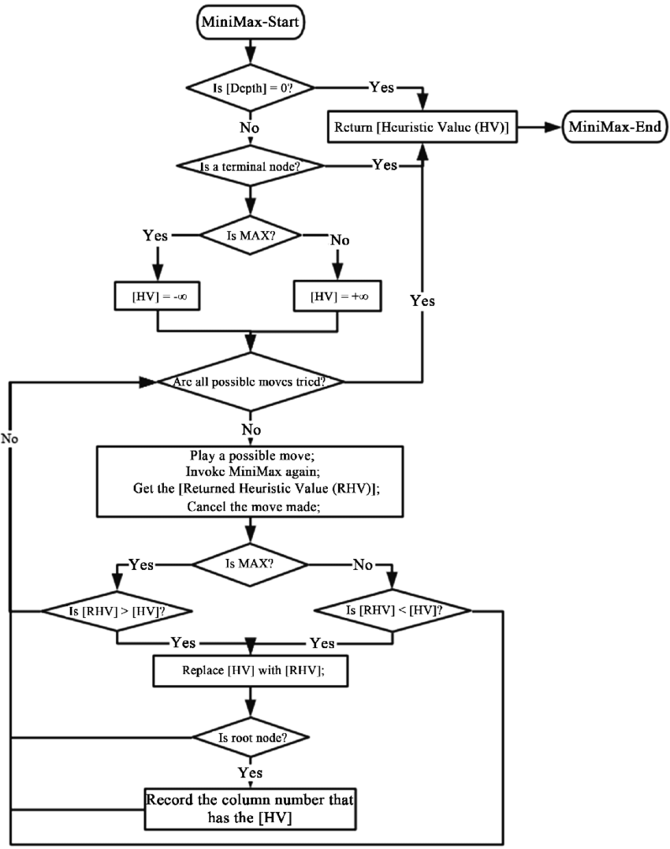
FLOWCHART FOR MINMAX ALGORITHM :

Slide 8
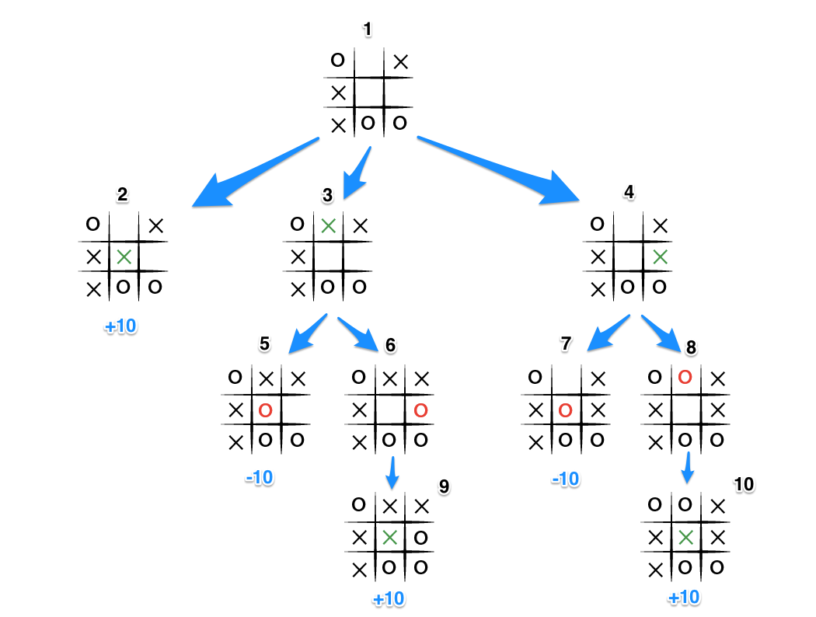
Activity Diagram

Slide 9
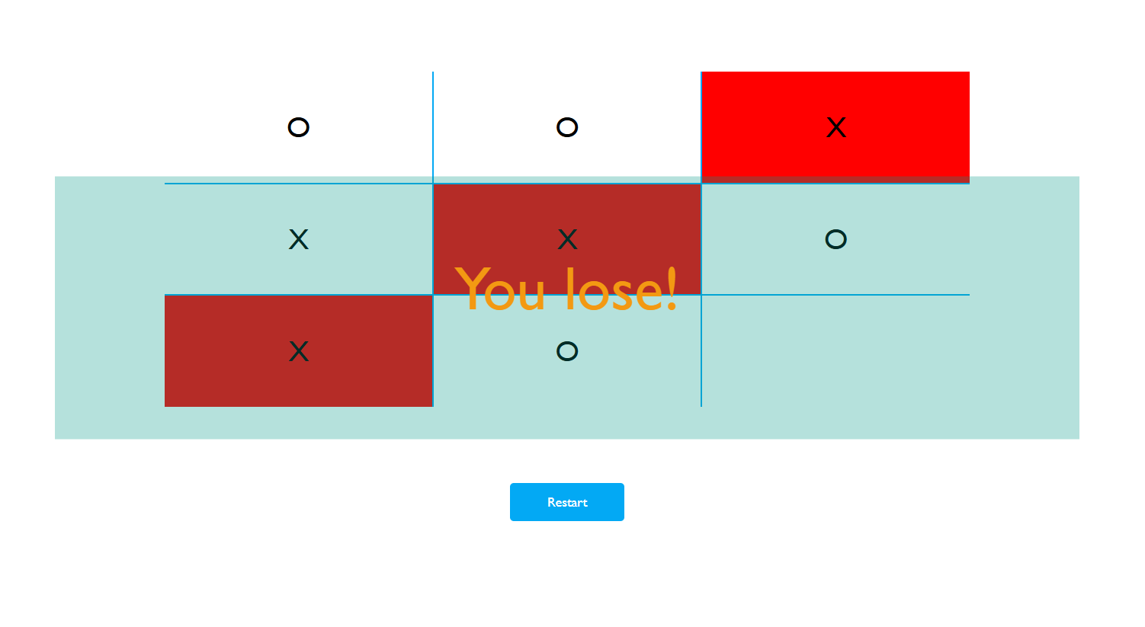
RESULTS Case 1 : you lose !

Slide 10
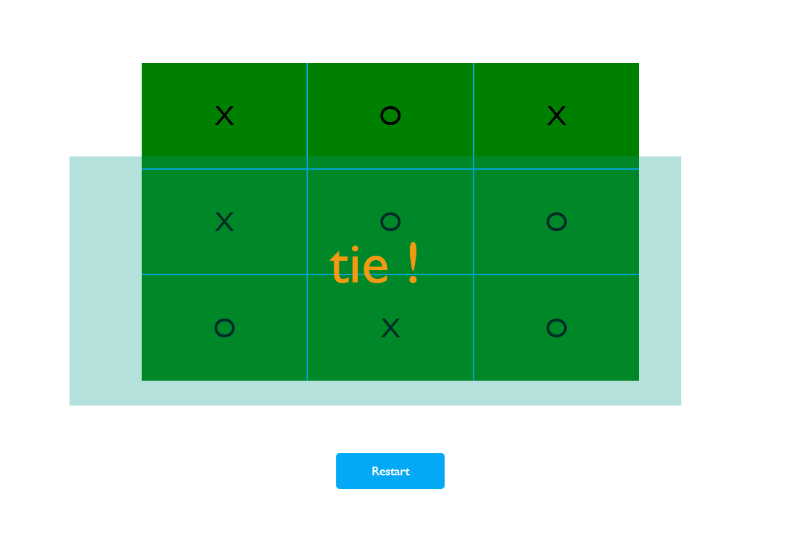
RESULTS Case 2 : tie !

Slide 11
Either you Lose or It’s a Tie
But You’ll Never Win

Slide 12
THANK YOU!

